Slide 1




Slide 2

IP PROJECT
जनमत
Submitted by :
1) Sampada 2010992077
2) Sanchit 2010992081
3) Shreshtha 2010992096
4) Shruti 2010992097

Slide 3


Introduction:
India, a vibrant democracy, values the voice of its citizens and provides them with the opportunity to elect their representatives through the voting system. However, the fairness and integrity of the electoral process have been compromised in various instances, posing challenges to the democratic principles enshrined in the Indian constitution.
06

Slide 4

Challenges Faced in the Electoral Process:
Insecurity at Polling Stations:
Corruption and Vote-Selling
Instances of the hijacking of polling
places undermine the trust and
fairness of elections, creating an
environment where voters may
feel coerced or influenced to
change their choice of representatives.
The prevalence of corruption in
some regions has led to voters
being compelled to sell their ballots
in exchange for cash. This undermines
the democratic principles and
diminishes the power of individual choices
Accessibility and Travel Constraints
Many citizens face difficulties in
traveling to polling stations,
particularly in remote areas,
leading to reduced voter
turnout and disenfranchisement.
03

Slide 5

Proposed Solution:
"Janmat"
"Janmat" is an innovative solution aimed at addressing the challenges faced by voters during elections in India.
Enhanced security measures
Anti-corruption measures
Improved Accessibility
Voter education and Awareness
Transparent electoral Processes
09

Slide 6
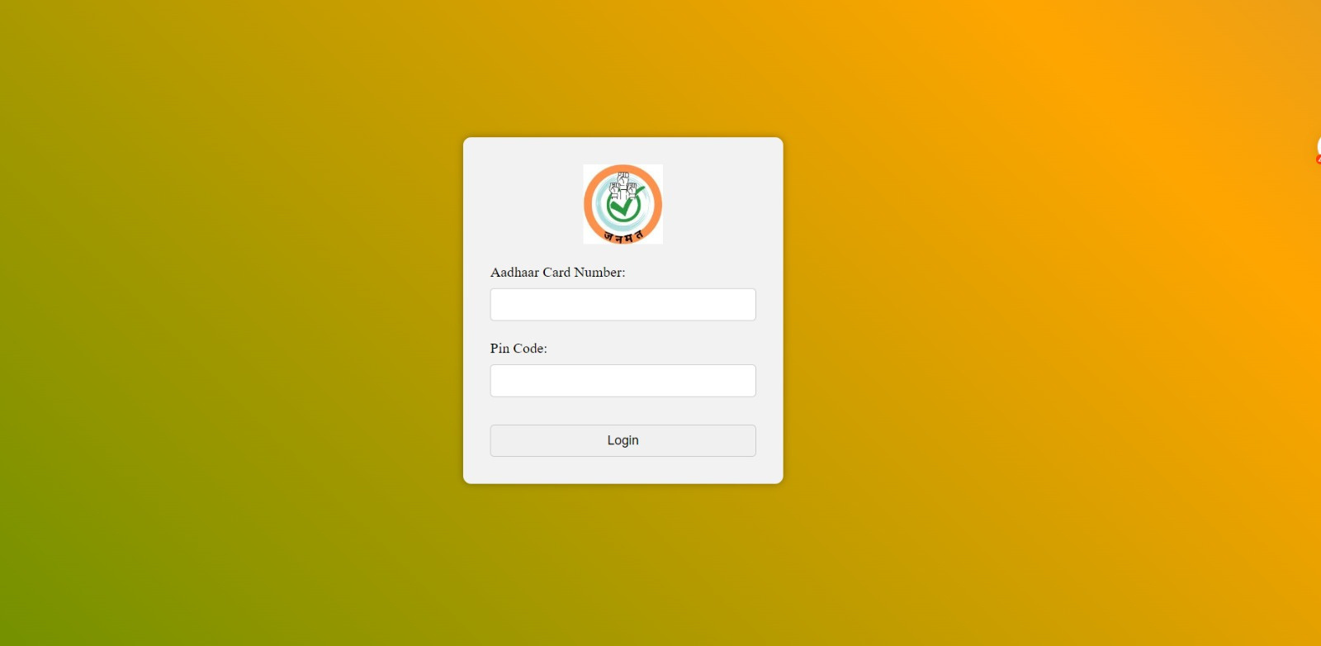
Login Page
people with invalid adhar card will not be able to login
people with invalid pinCode will not be able to login
If aadhar is not matched with pinCode the login will be denied
If the user is below the voting age the access will be denies
If the elections are not going in that area the access will be denies.

Slide 7
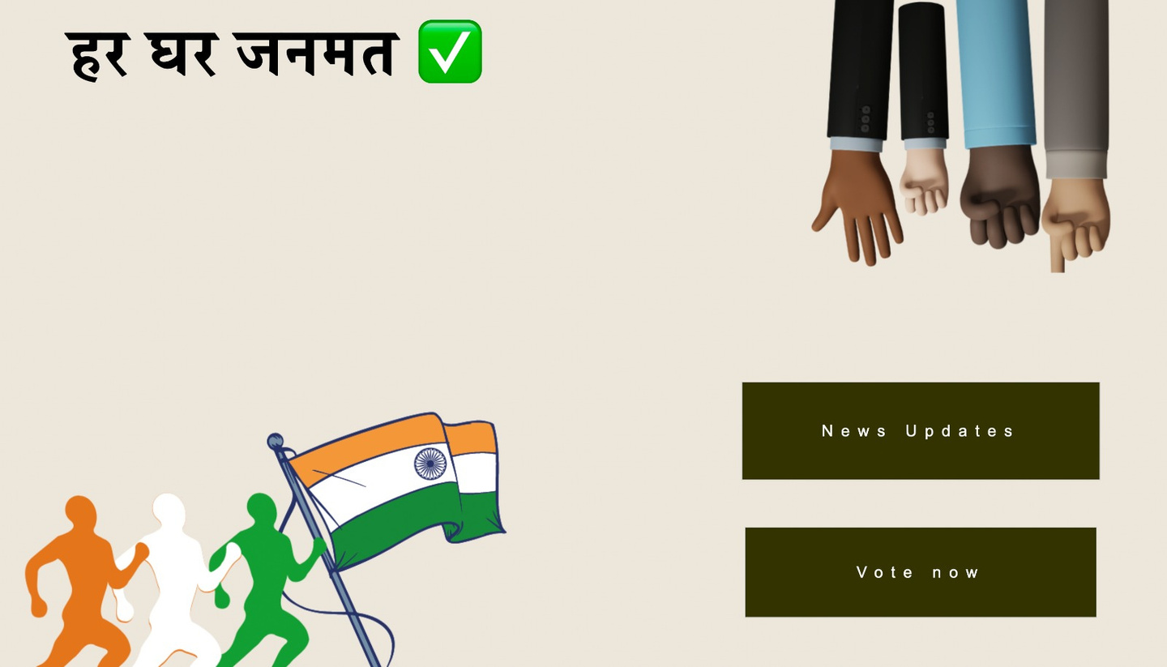


click on this button to look for news updates
click on this button to proceed with online voting

Slide 8
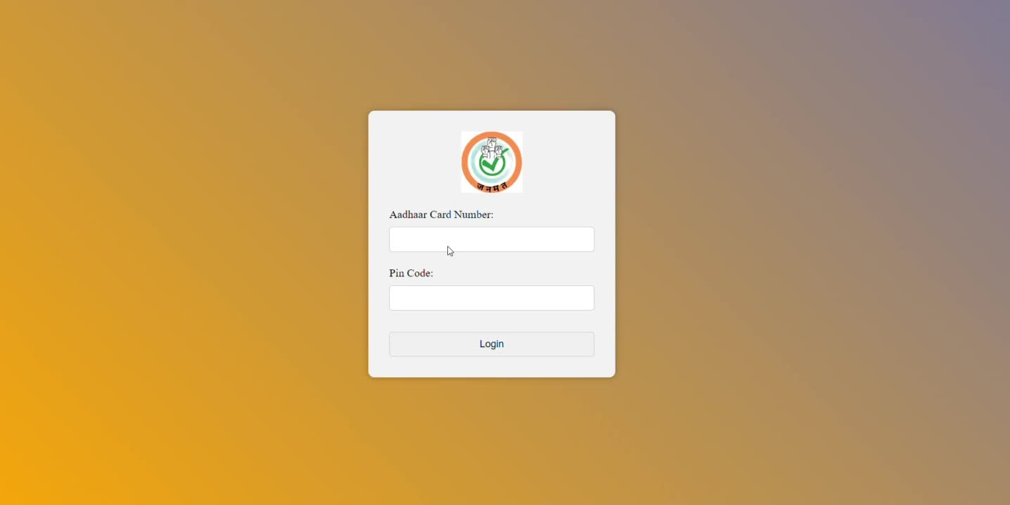

Slide 9
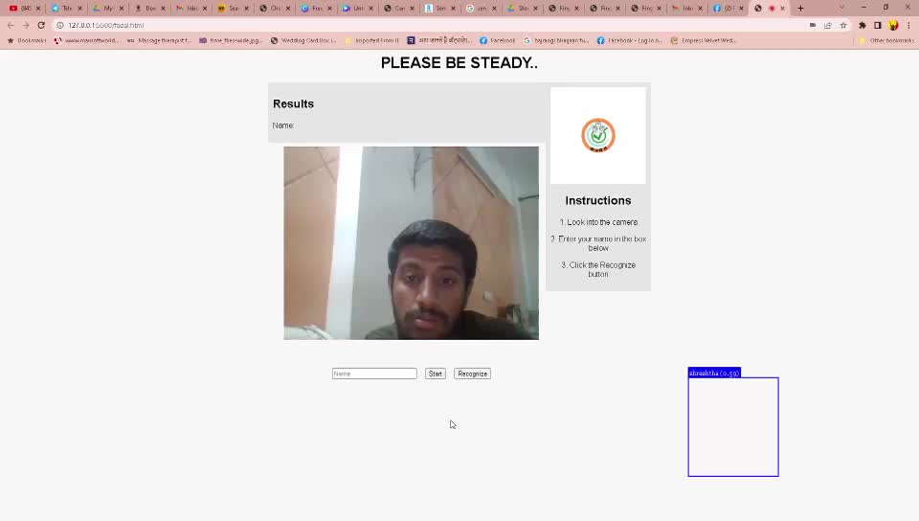
The instructions will help people in
navigating while using the website
The name entered in the name section
will be identified with the name where as the
other person will be denied with the access
This will be given as name, but if
user is not verified then name will be
given as UNKNOWN
The instructions will help in guiding the people while navigating through the website

Slide 10

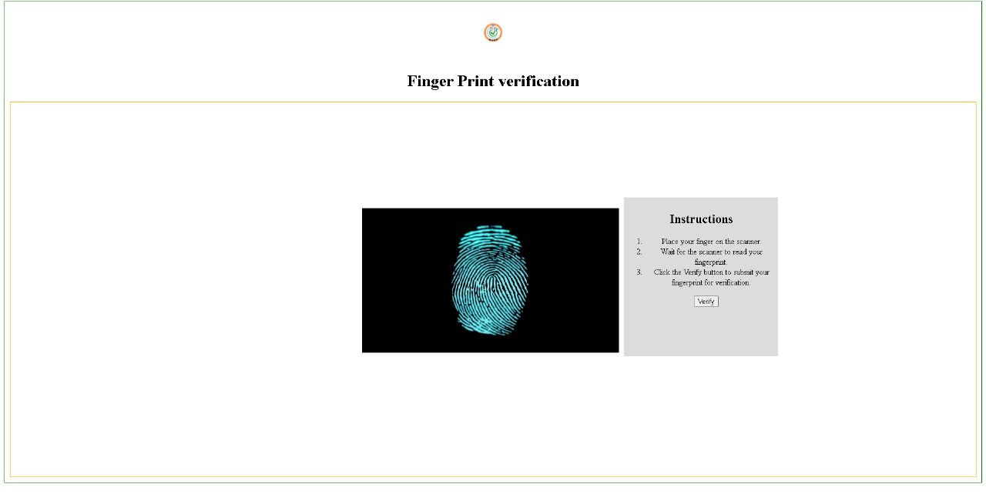
Once, the data is matched, the website
is navigated to the next page where the
voting process starts
The VERIFY button would further ask the permission
of the touch ID from the required device and then compare
the fingerprint data stored in the database
05

Slide 11
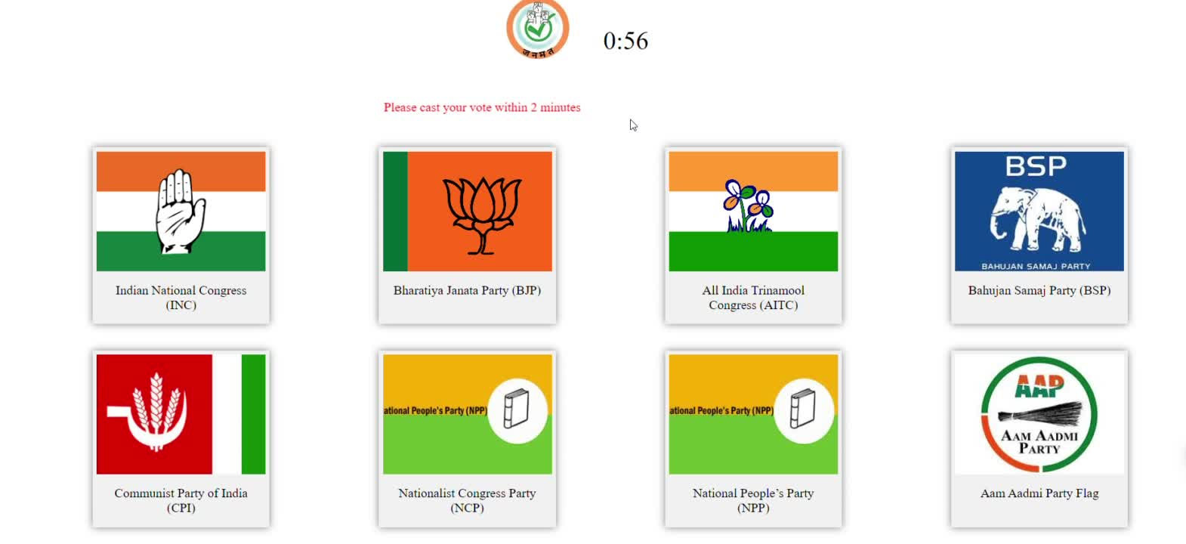
countdown to restrict voting time to 2 minutes only
notice the conformation box
asking the user to lock the vote or not?

Slide 12

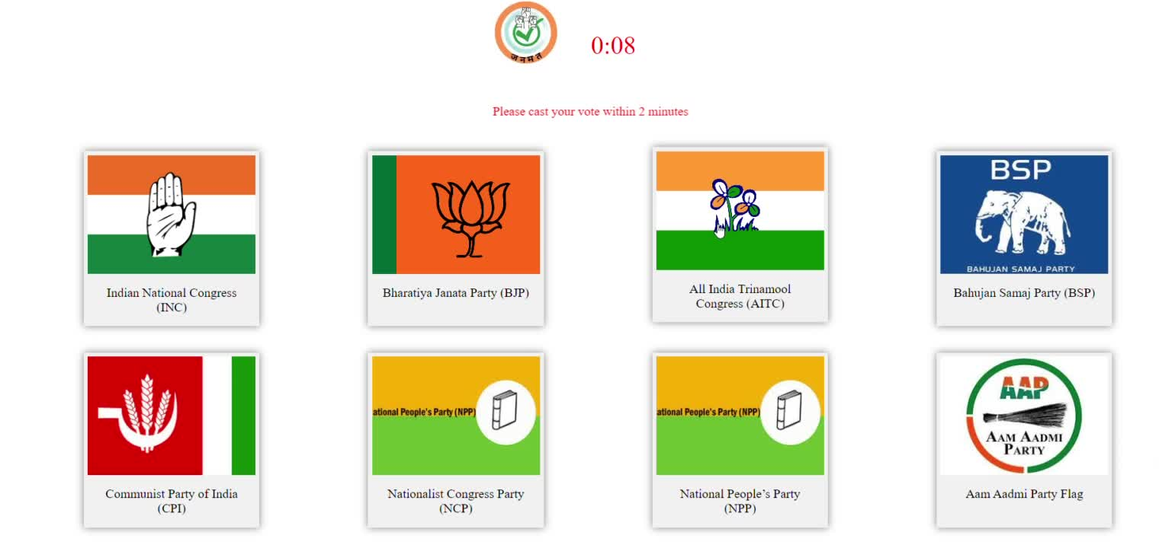

alert showing up at the end when the timer is completed
timer turns red when the time hits to 10seconds
as a warning to the user
disclaimer travelling across the screen

Slide 13
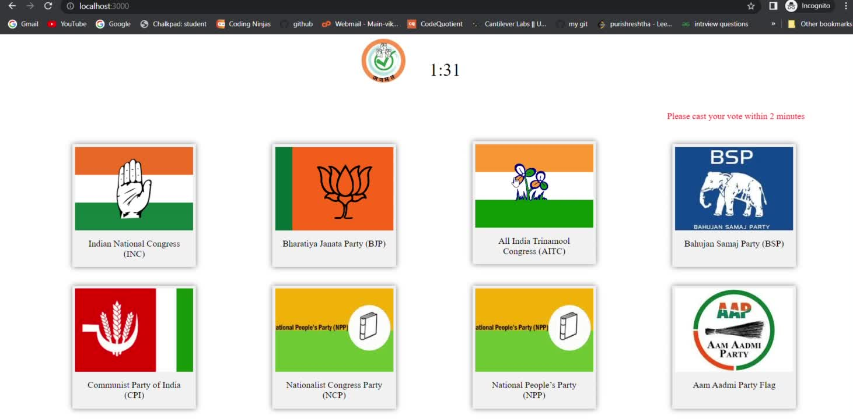

Slide 14
Conclusion:-
In India, the practise of picking politicians or parties
through the voting system faces issues such as insecurity,
corruption, and limited accessibility. However, by implementing
procedures such as those advocated by "Janmat," these
challenges can be addressed. India can strengthen its
electoral processes and create a more inclusive, fair, and
representative democracy for its citizens by prioritising
security, transparency, voter education, and accessibility.
NOTE :- The notion of "Janmat" is fictitious, and the given
solutions are broad suggestions based on the
issues outlined in the provided scenario.
08

Slide 15


